Slide 1
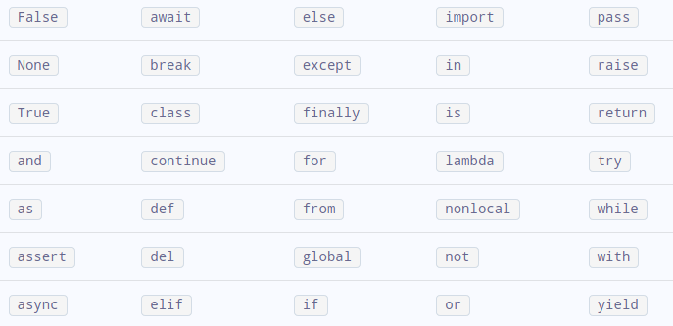
Keywords or Reserved Words

